Slide 1

Top 5 Cities for a Data Scientist
By Stephanie Halsing

Slide 2

Objective
I am a Data Scientist and would like to know the top 5 cities where my salary (in USD) will go the farthest with respect to the cost of living index for each city.

Slide 3
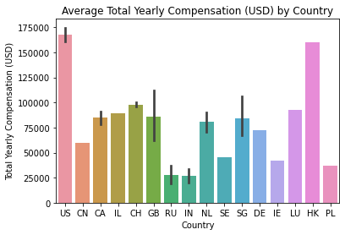
Notes:
Since I’m an entry-level Data Scientist, I’ve decided to look at salaries for Data Scientists with less than or equal to 1 year of experience.
As shown in the bar plot, the average total yearly compensation for Data Scientists in the United States (US) is $167k followed closely by Hong Kong (HK) which is $160k. Since the highest average is the US, I decided to look into US cities and their cost of living indexes to see what the top 5 cities would be for my salary.

Slide 4
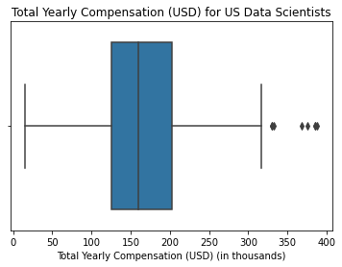
Summary Statistics for US Data Scientists
Min: 15,000
1st Quartile: 125,000
Median: 160,000
Mean: 167,938
3rd Quartile: 203,000
Max: 388,000
IQR: 78,000
Notes:
The interquartile range (IQR) indicates the spread between the 1st and 3rd quartiles and is not affected by outliers. Therefore, we will use this statistic to help determine my salary in respect to the cost of living index.
For US Data Scientists with less than or equal to 1 year of experience, the IQR is $78k which means the middle of this data ranges from $125,000 (1st quartile) to $203,000 (3rd quartile). By using the IQR, we can exclude the minimum and maximum numbers since these are considered outliers.

Slide 5
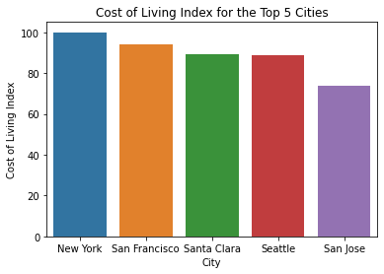
Notes:
With a baseline of 100, this means an index lower than 100 is less expensive compared to an index higher than 100.
In this barplot, we can see the city of San Jose, CA has the lowest cost of living index at 73.71 while New York, NY has the highest cost of living index at 100. Given a salary range of $125k to $203k, my salary would go the farthest if I were to live in San Jose, CA.
I also looked at the rent index which is 82.3. This is slightly higher than Seattle, WA with the lowest rent index of 65.84 out of these 5 cities. However, the groceries index for San Jose is 70.53 which is the lowest out of the 5 cities.

Slide 6
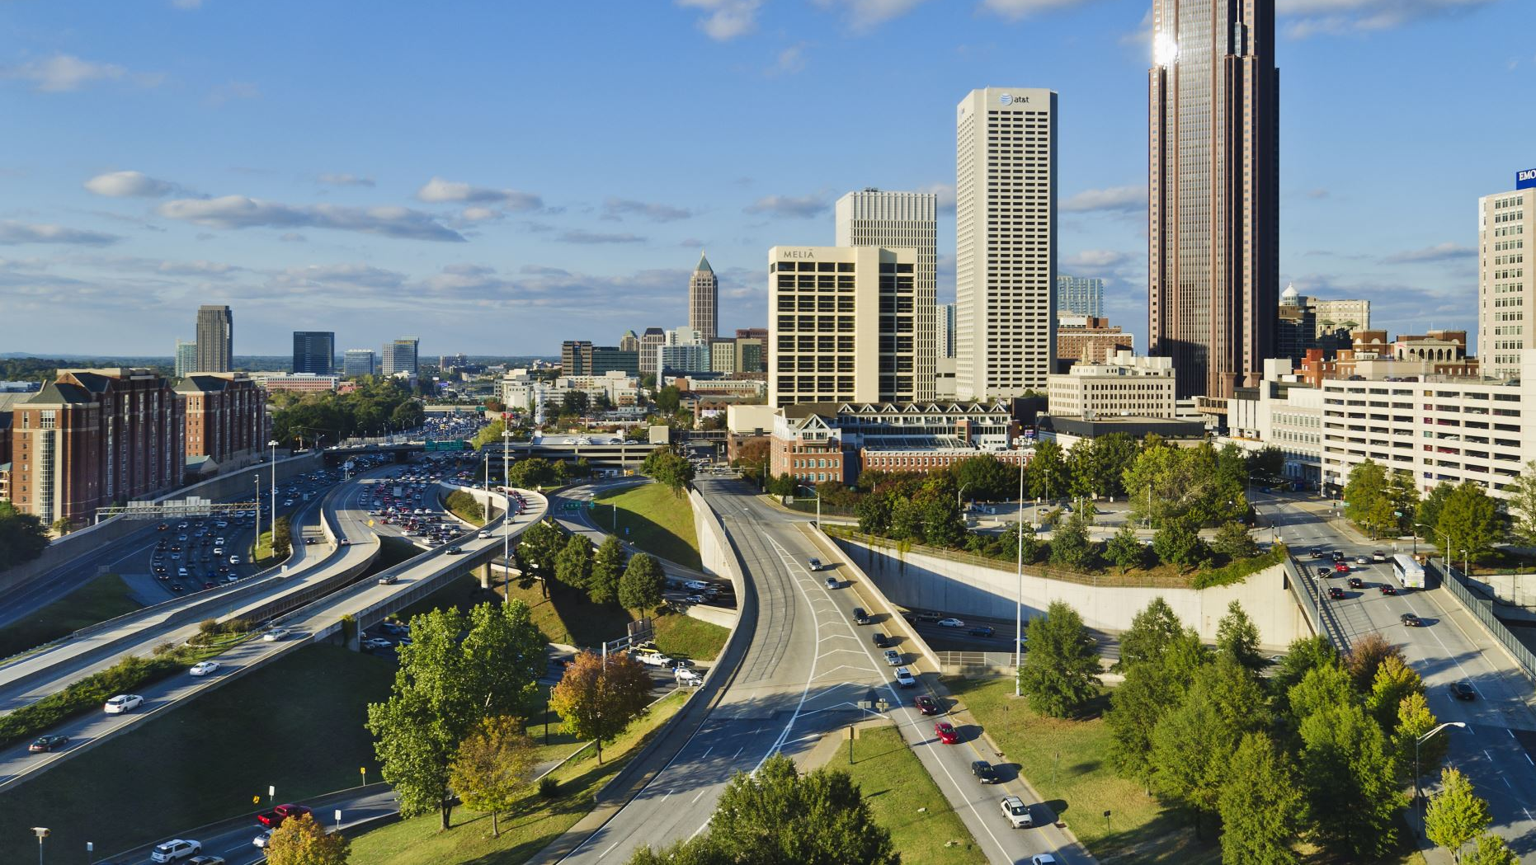
Conclusion
Here are the top 5 cities which my salary will go the farthest:
1. San Jose, CA
2. Seattle, WA
3. Santa Clara, CA
4. San Francisco, CA
5. New York, NY
Notes:
In conclusion, the potential salary by working in the US is much greater compared to other countries. The choice of cities to live in is endless but there were 5 that particularly stood when examining the data. My top city where my salary will go the farthest is San Jose, CA with a potential salary range of $125k to $203k.

